Slide 1
When we observe an image with our eyes, the image “persists” in our vision for about 1/25th of a second
We call this effect “persistence of vision” (or POV for short)
Older “tube” TVs rely on this effect to allow us to see a whole picture from a single bright dot that scans across the screen
The effect works particularly well with bright point light sources like LEDs. We can use it to have some fun!

Slide 2
Our POV globe uses a row of 24 LEDs which are mechanically scanned (“spun around”) to trace out the surface of a sphere in the air
The world map image has is 64 pixels wide and 24 pixels high
Every 1/64th of a turn we need to change the 24 LEDs to show the next vertical slice through the map image
It must take exactly 1 spin to show all 64 slices for the effect to work - this takes some careful timing!

Slide 3
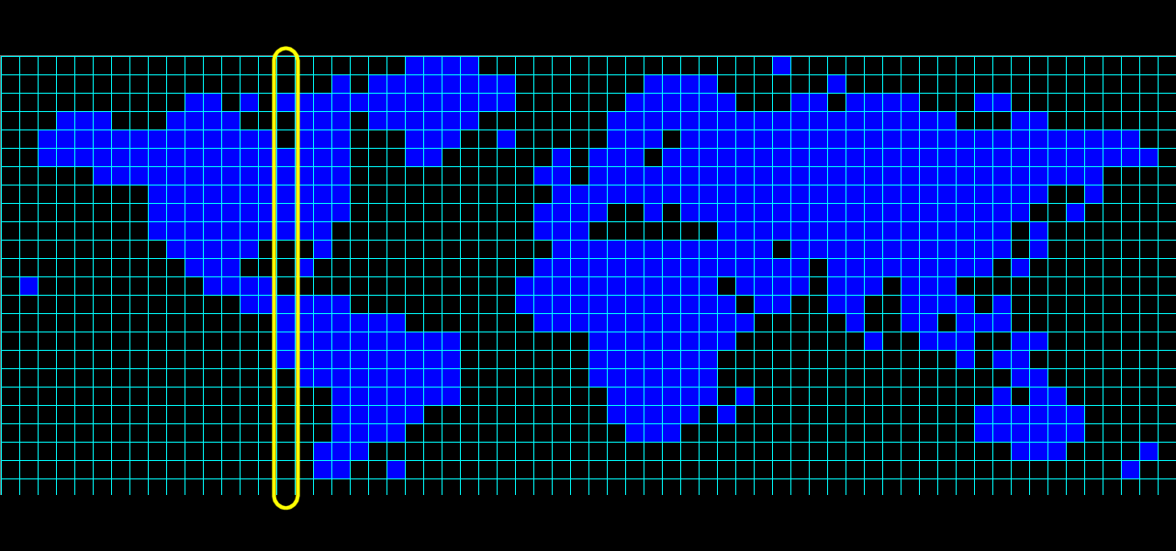
The image is a scaled down and edited version of a world map image we found on the internet

Slide 4
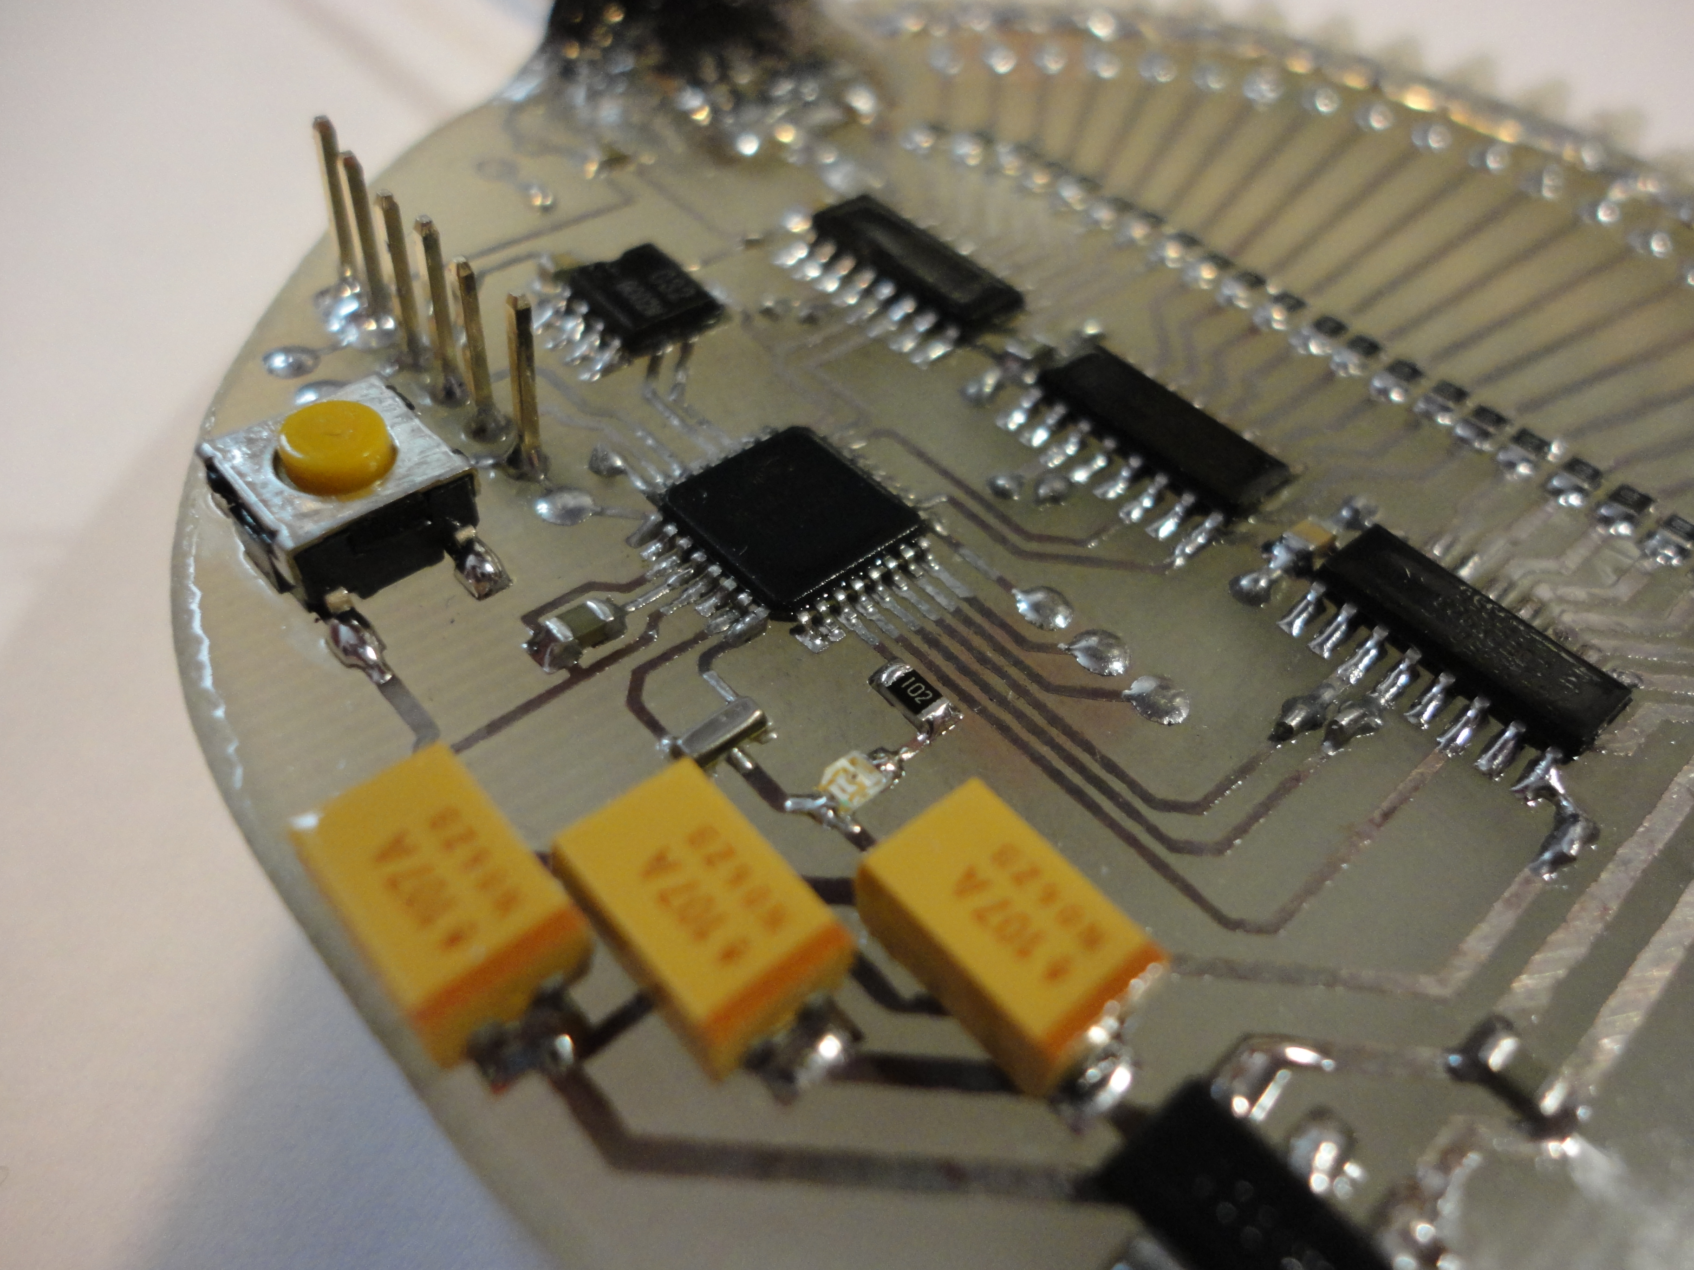
The globe works using a “microcontroller” - it's an entire computer on a chip!
Like a regular computer it runs programs we write for it, to do anything we like!

Slide 5
The globe is an Arduino project, but we made a custom Arduino board to get the size and weight down
The board was designed on the free EAGLE PCB program and home etched using toner transfer film and ferric chloride etchant
We use shift register components to help us drive all 24 LEDs easily
Using surface mount components allowed us to make a small, light and robust project but you can easily build a POV without them

Slide 6
We use a magnetic switch (“Hall Effect Switch”) to time the spins. The switch is triggered by a magnet fixed to the frame
Every time the switch passes the magnet, our program reads an internal timer and resets it to zero. This gives us our “revolution time”.
Every 1/64th of the revolution time we update the LEDs and move our “current slice” along through the image
The program adapts to the spin rate and does not need to be spun at any special speed

Slide 7
POV display projects have some unique challenges
* Mechanical bits - drive and balance!
* Timing the spin accurately
* Updating the LEDs fast enough
* Getting power to the rotating circuit

Slide 8
For accurate timing we need to use interrupts. These let us have parts of our program run immediately when external events are detected, such as the magnetic switch triggering
We also make use of the fast hardware-based timers that the microcontroller provides us with. These can also generate interrupts for accurate timing
To get data out to the LEDs quickly enough we need to write directly to the microcontroller's output ports (rather than using more familiar Arduino functions like digitalOut)

Slide 9
Power is often the biggest challenge - bright LEDs can use a fair bit of power, so batteries usually don't last long
We get power to our globe using carbon brushes (a common approach in electric motors)
Brushes create electrical noise so we use capacitors to store charge and smooth over any dips in the supply
Some POV projects use inductively coupled coils (like those used in electric toothbrush chargers)

Slide 10
POV projects are great fun to make yourself. They allow you to create a large “plot surface” using just a small number of LEDs and simple electronics. And they look cool :)
You could start simple with an Arduino board and some LEDs – move a camera to capture the image without moving the board. Or just wave it around
You can also run a rotating POV without position indexing (just guess at the timing or vary the speed of the motor!)
Good Luck!

